Slide 1
WEB 322 WEB PROGRAMMING TOOLS AND FRAMEWORKS
Week 9 - Lecture 1
MongoDB and Mongoose

Slide 2


Slide 3
MongoDB Overview
A database engine that allows you to create, manage and run NoSQL databases.
It is currently one of the most used/popular NoSQL database engines on the market.
MongoDB is also the name of the company that produced the product “MongoDB”.
MongoDB derived its name from the word “Humongous” because it was designed to store lots and lots of data.
When setting up a MongoDB, you have two versions to choose from:
Install a MongoDB on your own machine (local installation)
Run a database in the cloud (Atlas): www.mongodb.com/cloud/atlas

Slide 4
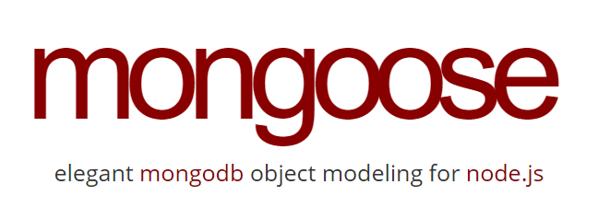

Slide 5
Mongoose
An ODM, specifically made to work with MongoDB databases.
It makes it easy to connect to and query a MongoDB database.
Provides a straight-forward, schema-based solution to model your application data.
Includes built-in type casting, validation, query building, business logic hooks and more, out of the box.
To use Mongoose in your Node/Express app:
Install the package: npm install mongoose
Import (require) the package: require(‘mongoose’)
Connect to and use the database.
See the official documentation: https://mongoosejs.com

Slide 6
Mongoose - Data Types
String: A variable length string.
Number: An integer.
Double: Floating point number.
Boolean: A Boolean (yes/no) column.
Date: A date and time.
Buffer: Binary data.
Mixed: Anything goes (no casting).

Slide 7
Mongoose – Defining a Schema
// Define a “User” model
const Schema = mongoose.Schema;
const UserSchema = new Schema({
fullName: String, // The user's full name (ie: "Jason Bourne")
title: String // The user's title within the project (ie, developer)
});
const User = mongoose.model(“users”, UserSchema);

Slide 8
Mongoose – CRUD Operations
Create:
var model = new Model({ … });
model.save((err) => { … });
Read:
Model.find({ … })
.exec()
.then((data) => { … });

Slide 9
Mongoose – CRUD Operations
Update:
Model.updateOne(
{ … query … },
{ $set: { … fields to set … }
).exec()
.then();
Delete:
Model.deleteOne({ … })
.exec()
.then();

Slide 10
Mongoose - Installation
To use Mongoose in your Node/Express app:
Install the package: npm install mongoose
Import (require) the package: require(‘mongoose’)
Connect to and use the database.
See the official documentation: https://mongoosejs.com/docs/guide.html

Slide 11

Live Demo
Create a MongoDb cluster
Add a database.
Explore the database.
Express App
Create a quick express app.
Create a model to use with Mongoose.
Perform CRUD operations on the database using Node.js.

